Slide 1
Javascript

Slide 2
Content
Tools & Environment Setup
GIT & Github Basics.
JavaScript Language Basics
How JavaScript Works Behind the Scenes
JavaScript in the Browser: DOM Manipulation and Events
Project 1 – The Dice Pig Game
Advanced JavaScript: Objects and Functions
Project 2 – The Budget App
Next Generation JavaScript: ES6+ / ES2015+
Asynchronous JavaScript: Promises, Async/Await and AJAX
Project 3 – The Recipe App - Modern JavaScript: Using ES6+, NPM, Babel and Webpack
Deployement on Github Pages.

Slide 3
Content - Detail
Tools & Environment Setup
    Download and Installation
    VS Code Extensions Intallation.
GIT & Github Basics.
JavaScript Language Basics
How JavaScript Works Behind the Scenes
JavaScript in the Browser: DOM Manipulation and Events
Project 1 – The Dice Pig Game
Advanced JavaScript: Objects and Functions
Project 2 – The Budget App
Next Generation JavaScript: ES6+ / ES2015+
Asynchronous JavaScript: Promises, Async/Await and AJAX
Project 3 – The Recipe App - Modern JavaScript: Using ES6+, NPM, Babel and Webpack
Deployement on Github Pages.

Slide 4
Class Wise Schedule
Tools & Environment Setup (Class 1)
GIT & Github Basics. (Class 1)
JavaScript Language Basics (Class 2)
How JavaScript Works Behind the Scenes (Class )
JavaScript in the Browser: DOM Manipulation and Events (Class )
Project 1 – The Dice Pig Game (Class )
Advanced JavaScript: Objects and Functions (Class )
Project 2 – The Budget App (Class )
Next Generation JavaScript: ES6+ / ES2015+ (Class )
Asynchronous JavaScript: Promises, Async/Await and AJAX (Class )
Project 3 – The Recipe App - Modern JavaScript: Using ES6+, NPM, Babel and Webpack (Class )
Deployement on Github Pages. (Class 16)

Slide 5
Tools &
Environment Setup
OS: Ubuntu Linux 18.04 LTS
Editor: VS Code
Browser: Chrome
Version Control: GIT
Online Code Repository: Github.com

Slide 6
Tools &
Environment Setup
OS: Ubuntu Linux 18.04 LTS
    Download URL: https://ubuntu.com/download/desktop
    Installation Tutorials
      Ubuntu Installation :
      https://tutorials.ubuntu.com/tutorial/tutorial-install-ubuntu-desktop#0
      Ubuntu Installation as Dual Boot with Windows:
      https://itsfoss.com/install-ubuntu-dual-boot-mode-windows
Editor: VS Code
    Download URL: https://code.visualstudio.com/download
Browser: Chrome
    Download URL: https://www.google.com/intl/en_sg/chrome/
Version Control: GIT
    Download URL: https://git-scm.com/downloads
    GIT Commands Cheetsheet:
      https://www.atlassian.com/dam/jcr:8132028b-024f-4b6b-953e-e68fcce0c5fa/atlassian-git-cheatsheet.pdf
Online Code Repository: Github.com
    Sign Up for Free Github.com Account: https://github.com

Slide 7
VS Code - Extensions
Auto Rename Tag
Live Server
Prettier
Useful Link: https://www.youtube.com/watch?v=bhu7-5x46BM

Slide 8
GIT
Distributed Version Controlling System (VCS).
Developed by Linus Torvalds, who is well known for Linux Kernel.
Most used VCS:
  https://insights.stackoverflow.com/survey/2018#work-_-version-control
GIT is Open Source hava a look at it’s code here: https://github.com/git/git
Good Read:
  https://guides.github.com/introduction/git-handbook/
  https://speakerdeck.com/schacon/introduction-to-git
  https://www.atlassian.com/git/tutorials/what-is-version-control

Slide 9
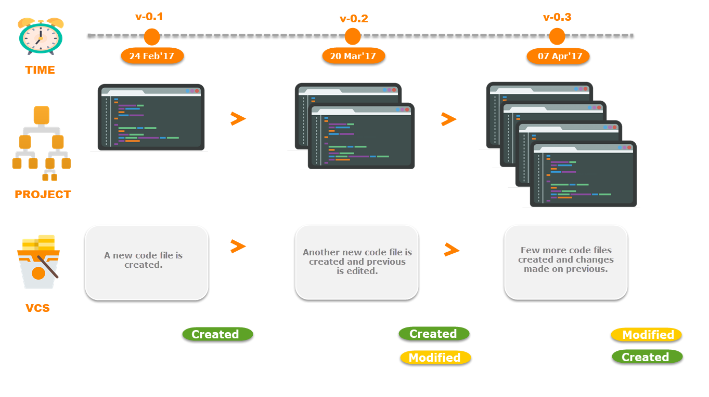
GIT
What Version Controlling System (VCS) ?
It is a software that maintain different versions of a file on computer system.

Slide 10
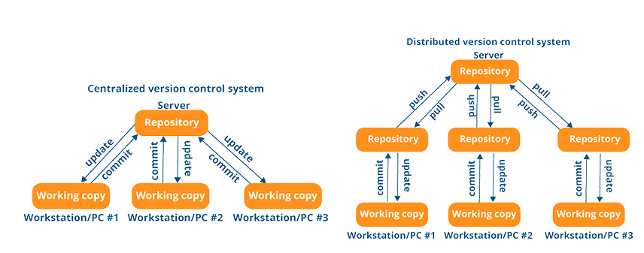
GIT
Centeral(C) vs Distributed(D) Version Controlling System (VCS)

Slide 11
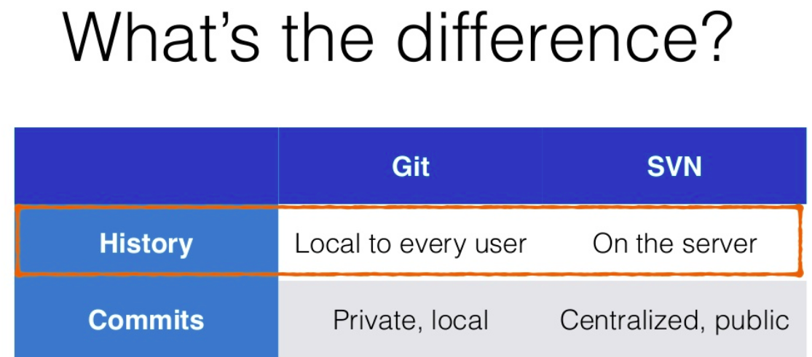
GIT

Slide 12
Javascript
Thank You

